Slide 1
INDUSTRY
READINESS PROGRAM
INTERVIEW WITH AN
INDIAN ARMY VETERAN
A journey of service, discipline and dedication
NAME
COLLEGE
Pavan Poojari
Presidency University
ROLL NO.
PROJECT
20261CSE0217
Veteran Interview
Industry Readiness Program • 1/5

Slide 2
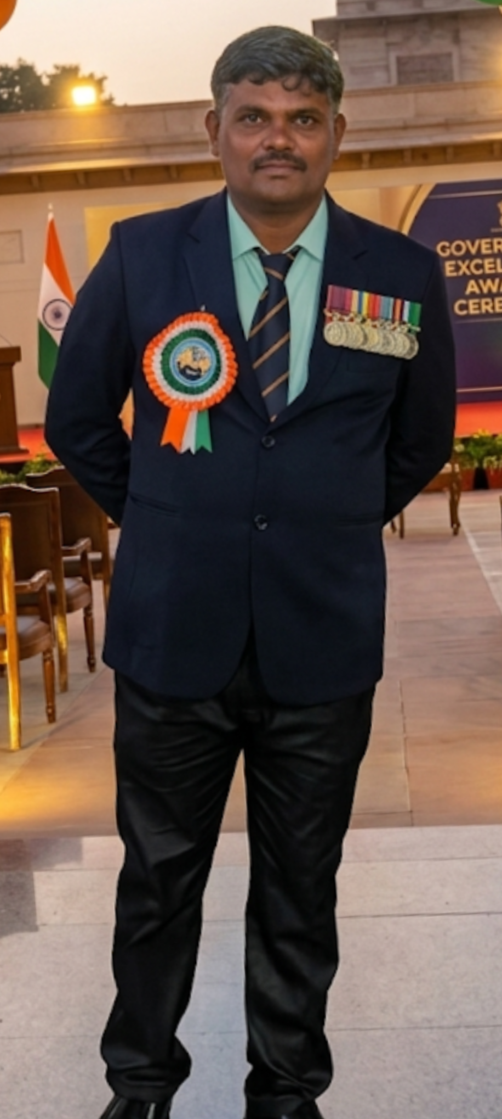

THE PERSON I INTERVIEWED
VETERAN PROFILE
SUBEDAR KANDU KULE
Naik Subedar • 30 Years of Service
RANK
Naik Subedar
YEARS OF SERVICE
30 Years
STATUS
Indian Army Veteran
30 years of service reflects a lifetime of dedication to the nation.
Industry Readiness Program • 2/5

Slide 3
INTERVIEW: QUESTIONS & ANSWERS
7 QUESTIONS
01
Why did you join the Indian Army?
02
What was your most memorable experience?
I wanted to serve my country and contribute to the safety and security of the nation.
Serving alongside fellow soldiers and facing challenging situations together were memorable experiences.
03
What was the biggest challenge during your service?
04
What did 30 years in the Army teach you?
Adapting to difficult conditions while maintaining discipline, courage and responsibility was a major challenge.
It taught me discipline, patience, teamwork, leadership and dedication.
05
What qualities should a good soldier have?
06
What advice would you give to students?
Courage, discipline, honesty, teamwork and a strong sense of responsibility.
Work hard, stay disciplined, respect others and remain committed to your goals.
07
What does serving the nation mean to you?
It is a matter of pride and responsibility—putting the nation's interests above personal comfort.
Industry Readiness Program • 3/5

Slide 4
MY EXPERIENCE WITH THE VETERAN
REFLECTION
What I learned
“The interview helped me understand the value of discipline, courage and service.”
01
Discipline
Small habits and consistency build strong character.
02
Responsibility
Serving others requires commitment and accountability.
03
Teamwork
Trust and cooperation are essential when facing challenges.
MY KEY TAKEAWAY
Respect is earned through responsibility, consistency and dedication.
04
Dedication
Long-term success requires patience and determination.
Industry Readiness Program • 4/5

Slide 5
THANK YOU
“A soldier’s service may end, but the values of courage,
discipline and dedication remain forever.”
JAI HIND!
Presented by Pavan Poojari
20261CSE0217 • Presidency University
Industry Readiness Program • 5/5

